Slide 1

BANGALORE INSTITUTE OF TECHNOLOGY
K.R Road, V.V Pura, Bengaluru-04
DEPARTMENT OF ARTIFICIAL INTELLIGENCE & MACHINE LEARNING
“A New High Capacity Image Steganography Method Combined With Image Elliptic Curve Cryptography and Deep Neural Network”
Presented by
USN Name
1BI20AI032 NEHA B K
VIII Semester
Under the Guidance of
Prof. Yamini Sahukar P
Assistant Professor

Slide 2
Agenda
Introduction
Literature Review
Problem Statement
Proposed System
Architecture
Proposed Schema
Results (Graph / Tables)
Applications
Conclusion
References
1/29

Slide 3
Introduction to topic
The paper titled "A New High Capacity Image Steganography Method Combined With Image Elliptic Curve Cryptography and Deep Neural Network" presents a novel image steganography method combining Discrete Cosine Transform (DCT), Error Correction Code (ECC), and a Deep Neural Network (DNN).
The proposed framework comprises three stages: preprocessing, steganography, and extraction. In the preprocessing phase, an original image undergoes DCT and ECC to generate a secret image and an encrypted version. The steganographic process involves utilizing a SegNet-based DNN for embedding the encrypted image into a host image, resulting in a container image
2/29

Slide 4
Introduction to topic
The extraction phase employs another DNN to recover the secret image. The method aims to enhance security and privacy by utilizing ECC encryption and leverage DNNs for efficient steganography without compromising visual quality.
Experimental evaluations demonstrate the effectiveness of the proposed approach in terms of Peak Signal-to-Noise Ratio (PSNR), Structural Similarity Index (SSIM), payload capacity, and resistance against steganalysis tools.
3/29

Slide 5
Literature Review
Sl. No. | Title | Author | Year of Publication | Adopted Methodology | Limitations
1. | A tamper-detection scheme for BTC-compressed images with high-quality images | S. Nguyen, C.-C. Chang, and T.-F. Chung | 2023 | The proposed scheme involves two phases: authentication code embedding and tamper detection. Authentication codes are generated using a pseudo-random number generator and a secret key. | The proposed scheme may experience reduced visual quality as the number of authentication code bits increases.
2. | Use of elliptic curve cryptography for multimedia encryption | L. Tawalbeh, M. Mowafi, and W. Aljoby | 2021 | The methodology employs elliptic curve cryptography (ECC) for multimedia encryption. Selective encryption targets specific parts during compression, while perceptual encryption encrypts higher-order bitplanes before compression, ensuring real-time efficiency and security. | A drawback is the need for modifications in compression algorithms when applying ECC during compression for selective encryption, potentially complicating the integration with existing codecs.
5/20

Slide 6
Literature Review
Sl. No. | Title | Author | Year of Publication | Adopted Methodology | Limitations
3. | Image Encryption using Elliptic Curve Cryptography | L. D. Singh and K. M. Singh | 2022 | It incorporates pixel grouping to enhance computational efficiency, utilizes ECC mathematical operations, and integrates digital signatures. The process ensures authenticity and integrity during encryption and decryption, demonstrating effectiveness through comprehensive security analyses | Drawbacks include potential sensitivity to key changes, reliance on pixel grouping, and the need for careful key management in certain scenarios.
4. | Dual Stego-imaging Based Reversible Data Hiding Using Improved LSB Matching | A. Sahu and G. Swain | 2019 | The methods involve LSB matching on mirrored images or creating two stego-pixels from one original pixel, allowing data concealment with preserved image quality and reversible extraction | Despite increased hiding capacity, the proposed techniques may face challenges in resisting certain analyses
5/20

Slide 7
Literature Review
Sl. No. | Title | Author | Year of Publication | Adopted Methodology | Limitations
5. | Large-scale JPEG image steganalysis using hybrid deep-learning framework | J. Zeng, S. Tan, B. Li, and J. Huang | 2016 | The first stage involves convolution and quantization phases using hand-crafted DCT patterns. The second stage employs a compound CNN network with three subnets processing quantized residuals, generating feature vectors for prediction. Training involves ImageNet and model ensemble enhances performance. | Drawbacks include limited explanation of the hand-crafted stage's specific design choices, the need for large-scale datasets, and lacking an in-depth comparison with existing models on smaller-scale datasets for comprehensive evaluation.
6. | Designing steganographic distortion using directional filters | V. Holub and J. Fridrich | 2023 | The methodology involves utilizing directional high-pass filters to measure directional residuals, reflecting the predictability of pixel content. Aggregating these residuals using a unique rule guides adaptive embedding, enhancing resistance to steganalysis. | One drawback is the reliance on additive distortion, potentially limiting interactions between embedding changes. Non-additive distortion and improved directional filter banks could further enhance security and robustness.
5/20

Slide 8
Literature Review
Sl. No. | Title | Author | Year of Publication | Adopted Methodology | Limitations
7. | Adaptive Edge Steganography for Images | Yambem Jina Chanu, Kh. Manglem Singh and Themrichon Tuithung | 2023 | The methodology involves utilizing Roberts edge detection and LSB embedding to conceal messages within image edges adaptively. The process enhances security by making it challenging for steganalytic tools to detect hidden information. | A potential drawback is the reliance on edge detection, making the proposed technique susceptible to limitations in accurately identifying edge regions, which may impact the overall effectiveness of message concealment.
8. | Graphical Password Authentication System Using Modified Intuitive Approach | Abhishek Narayan Shah, Dipti Anand, Sabyasachi Samanta and Dipankar Dey | 2021 | The paper likely employs high-dimensional image models to develop steganographic methods, focusing on embedding hidden data in images while minimizing detection by leveraging advanced mathematical and statistical techniques. | Possible limitations may include computational complexity due to high-dimensional models, reliance on specific image characteristics that may not be universally applicable, and susceptibility to evolving detection methods as steganalysis techniques advance over time.
5/20

Slide 9
Literature Review
Sl. No. | Title | Author | Year of Publication | Adopted Methodology | Limitations
9. | Digital image encryption algorithm based on elliptic curve public cryptosystem | X. Zhang and X. Wang | 2019 | The methodology centers on developing an asymmetric image encryption algorithm through the fusion of Elliptic Curve Cryptosystem (ECC) and chaotic systems. It begins with an introduction to ECC and chaotic systems. The core of the methodology lies in, which details the design of the novel algorithm. | The paper's limitations include a lack of comprehensive evaluation of similar algorithms, theoretical emphasis without empirical validation, simplicity in encryption techniques possibly overlooking complexities.
10. | Large-scale JPEG image steganalysis using hybrid deep-learning framework | J. Zeng, S. Tan, B. Li, and J. Huang | 2018 | The paper proposes a hybrid deep-learning framework for JPEG, comprising hand-crafted components simulating rich steganalytic models and a compound deep-neural network. Experimental validation on ImageNet datasets demonstrates improved detection performance and robustness to JPEG artifacts. | Limitations include the framework's initial stage in adopting deep learning for image steganalysis, potential challenges in integrating domain knowledge, and reliance on experimental evidence without comprehensive theoretical underpinning.
5/20

Slide 10
Literature Review
Sl. No. | Title | Author | Year of Publication | Adopted Methodology | Limitations
11. | Coverless Information Hiding Based on Robust Image Hashing | Donghui Hu | 2020 | The methodology involves robust image hashing to generate unique image fingerprints. Information is embedded by altering these hashes, maintaining image quality. Robustness against image operations and security are ensured. Evaluation tests capacity, quality, and security, validating the method's effectiveness in coverless information hiding. | In this paper even though the system is robust and secure, it lacked in handling the large volume of data. Doubled the capacity of steganography compared with the method, but the capacity is still much less than that of traditional steganography.
12. | Image Steganography: A Review of the Recent Advances | Nandhini Subramanian, Omar Elharrouss, Somaya Al-Maadeed, Ahmed Bouridane | 2021 | The methodology likely involves systematic literature search, data extraction, and analysis of recent advancements in image steganography techniques. It may include criteria for study selection, data synthesis methods, and any limitations encountered during the review process. | GAN is the extensively used and most preferred architecture over the autoencoder and statistical methods. Traditional methods are less secure as it is only a matter of detection of presence of the secret message.
5/20

Slide 11
Literature Review
Sl. No. | Title | Author | Year of Publication | Adopted Methodology | Limitations
13. | Elliptic Curve Lightweight Cryptography | Carlos Andres Lara-Nino, Arturo Diaz-Perez, Miguel Morales-Sandoval | 2018 | The paper conducts a systematic review of 91 papers from major electronic collections, focusing on "lightweight" elliptic curve cryptography. Papers are categorized based on proposed protocols, algorithms, realizations. Data is surveyed for factors like lightweight criteria, abstraction levels, main goals, implementation technology. | In this There are multiple threats that can compromise the security of ECLC systems. The development of new networked environments will require strong security primitives which are efficient and represent small overheads for the device.
14. | Object Detection Using Deep Learning, CNNs and Vision Transformers | Ayoub Benali Amjoud, Mustapha Amrouch | 2023 | The methodology involves traditional object detection methods, which use techniques like sliding windows and feature extraction, including Haar-like features. Classification is done using Support Vector Machine. Shifting to neural networks, revolutionized object detection. | Traditional object detection methods using sliding windows are computationally intensive and prone to generating duplicate windows. Reliance on manual feature design limits adaptability.
5/20

Slide 12
Literature Review
Sl. No. | Title | Author | Year of Publication | Adopted Methodology | Limitations
15. | Error-Correcting Codes and the Power of Machine Learning: Enhancing Data Reliability | Imrane Chems Eddine Idrissi, Said Nouh; El Mehdi Bellfkih, Abdelaaziz Marzak, Mohammed El Assad Assad | 2023 | The methodology encompasses traditional error correction techniques, alongside the integration of machine learning for improved decoding. It involves preprocessing data, selecting appropriate models, tuning hyperparameters, training, evaluating, and optimizing models, aiming for enhanced error correction performance and reliability across diverse applications. | Traditional error correction techniques may struggle with complex error patterns and high error rates. They often require extensive computational resources and struggle to adapt to dynamic environments.
12/29

Slide 13
Problem Statement
“A New High Capacity Image Steganography Method Combined With Image Elliptic Curve Cryptography and Deep Neural Network“
Objectives:
The paper aims to evaluate the performance of the proposed steganography method through experimental simulation.
To assess the results of image preprocessing, including DCT and ECC processing, and evaluate the effectiveness of the steganographic process using DNNs for embedding and extracting secret images within host images
To investigate the steganographic capacity of the proposed method, including assessing the payload capacity of information embedded within images and comparing it with existing steganography methods.
13/29

Slide 14
Proposed System
Novel Image Steganography Method: Combine DCT, ECC, and DNNs for high-capacity embedding.
Experimental Evaluation: Performance assessed using Python and Pytorch on specific hardware.
Preprocessing and Embedding: Evaluate DCT preprocessing and DNN-based embedding.
Performance Metrics Analysis: Assess PSNR, SSIM to gauge steganographic quality.
Detection Resistance Assessment: Conduct statistical analysis for resistance against StegExpose.
Steganographic Process: Embeds secret images into host images using the trained DNN model.
14/29

Slide 15
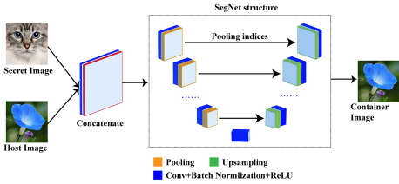
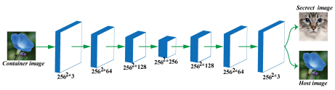
Architecture
Fig 1. Hiding network structure.
Fig 2. Revealed network structure.
15/29

Slide 16
Architecture
Image Preprocessing: Initial preprocessing of images using Discrete Cosine Transform (DCT) and Error Correction Coding (ECC) to obtain a secret image.
Deep Neural Network (DNN): Utilized for embedding the secret image into a host image. The DNN model, likely based on SegNet or similar architecture, is trained to perform this embedding process.
Training Environment: Python 3.6 programming language and PyTorch framework are used for developing and training the DNN model. The training is performed on a system with dual NVIDIA 1080 Ti GPUs, 16GB RAM, 1TB HDD, and 256GB SSD running Ubuntu operating system.
16/29

Slide 17
Architecture
Experimental Analysis: The performance of the proposed system is evaluated through experimental simulations, including image hiding, training iterations, and steganographic quality assessment.
Performance Evaluation: Metrics such as Peak Signal-to-Noise Ratio (PSNR), Structural Similarity Index (SSIM), and steganographic capacity analysis are employed to assess the quality and effectiveness of the steganography method.
17/29

Slide 18
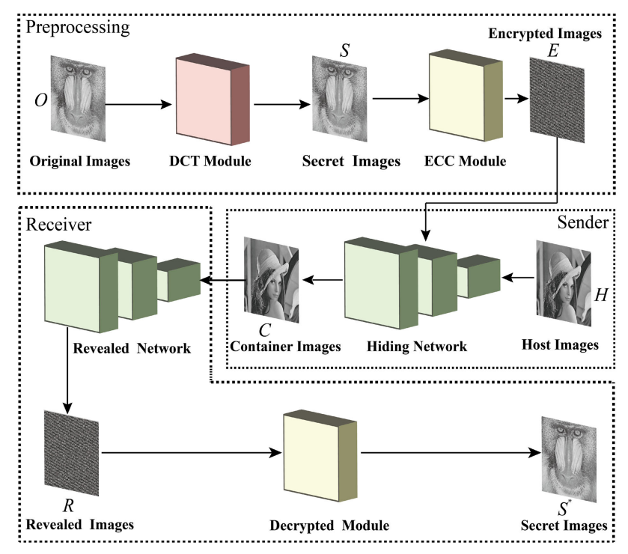
Proposed Schema
Fig 3. Flow chart of the proposed scheme.
18/29

Slide 19
Proposed Schema
Image Preprocessing: Apply Discrete Cosine Transform (DCT) to the original image to obtain frequency domain representation. Utilize Error Correction Coding (ECC) on the transformed image to generate a secret image with added noise.
Deep Neural Network (DNN) Training: Use a DNN model (e.g., SegNet) trained on a dataset consisting of host images and corresponding secret images. Train the DNN to embed the secret image into the host image while minimizing visual distortion.
19/29

Slide 20
Proposed Schema
Steganographic Embedding: Given a host image and a secret image, utilize the trained DNN to embed the secret image into the host image. Ensure that the embedding process does not significantly affect the visual quality of the host image.
Steganographic Extraction: Use the trained DNN to extract the secret image from the steganographically embedded image. Reverse the ECC process to recover the original secret image from the extracted data.
Performance Evaluation: Assess the quality of steganography using metrics such as Peak Signal-to-Noise Ratio (PSNR) and Structural Similarity Index (SSIM).
20/29

Slide 21
Results
Successful transformation of original images using DCT and ECC to generate noisy secret images.
Effective training of the DNN model (e.g., SegNet) to embed and extract secret images into/from host images. Improvement in training effect with increasing iterations, achieving indistinguishable results compared to original images.
Demonstrated successful embedding and extraction of secret images into/from host images. Minimal visual distortion in host images after embedding.
21/29

Slide 22
Results
High PSNR and SSIM values (>40 dB and >0.96, respectively) indicating minimal distortion in steganographic images. Steganographic capacity analysis showing the ability to hide significant amounts of information in images (e.g., 1 byte/pixel).
Resistance to steganalysis tools such as StegExpose, with ROC curves showing better performance than random guessing.
22/29

Slide 23
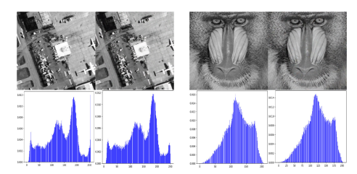
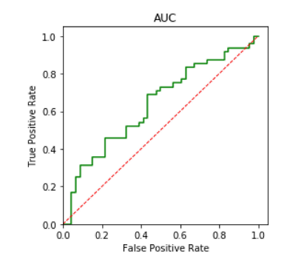
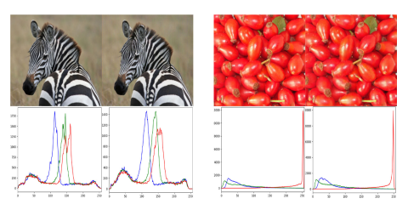
Results
Fig 4. The difference between Host image and secret image
Fig 5. ROC Curves: Detecting Steganography via StegExpose
23/29

Slide 24
Applications
Secure Communication: Concealing sensitive information within images enhances the security of communication channels, making it suitable for secure messaging applications.
Medical Imaging: Protecting patient data in medical images ensures privacy compliance, making the method valuable in healthcare applications.
Digital Watermarking: Embedding imperceptible watermarks within images for copyright protection and authentication, ensuring the integrity of digital assets.
Forensic Investigations: Covertly embedding information in images can aid forensic experts in discreetly tagging and tracking digital evidence.
24/29

Slide 25
Applications
Secure Cloud Storage: Concealing data within images before storage provides an additional layer of security, especially in cloud-based storage systems.
Authentication and Access Control: Integrating steganography for secure authentication methods, ensuring the confidentiality of access credentials.
Journalism and Whistleblowing: Concealing sensitive information within images facilitates secure communication for journalists and whistleblowers, protecting their identities.
Anti-Counterfeiting in Manufacturing: Embedding covert information in product images for anti-counterfeiting measures, aiding in the identification of genuine products.
25/29

Slide 26
Conclusion
The paper introduces a novel method employing a Deep Neural Network (DNN) Model for image steganography and extraction.
The method utilizes Discrete Cosine Transform (DCT) and an Error Correction Code (ECC) technique on the original image to generate a "Secret image" for steganographic embedding.
The Secret image initially appears noisy due to the ECC conversion.
The embedding process employs the SegNet deep network model to embed the classified image into the host image.
This embedding process doesn't require direct modification of the host image, preserving its visual quality and enhancing anti-detection properties.
The method ensures a certain capacity for steganography while maintaining flexibility.
Since a Deep Neural Network model is employed, adjustments in parameters suffice during embedding and extraction, eliminating the need for manual algorithm design and enhancing flexibility.
26/29

Slide 27
References
[1] S. Nguyen, C.-C. Chang, and T.-F. Chung, ‘‘A tamper-detection scheme for BTC-compressed images with high-quality images,’’ KSII Trans. Internet Inf. Syst. vol. 8, no. 6, pp. 2005–2021, 2014.
[2] L. Tawalbeh, M. Mowafi, and W. Aljoby, ‘‘Use of elliptic curve cryptography for multimedia encryption,’’ IET Inf. Secur., vol. 7, no. 2, pp. 67–74, Jun. 2013.
[3] L. D. Singh and K. M. Singh, ‘‘Image encryption using elliptic curve cryptography,’’ Procedia Comput. Sci., vol. 54, pp. 472–481, 2015.
[4] A. Sahu and G. Swain, ‘‘Dual stego-imaging based reversible data hiding using improved LSB matching,’’ Int. J. Intell. Eng. Syst., vol. 12, no. 5, pp. 63–73, Sep. 2019.
[5] J. Zeng, S. Tan, B. Li, and J. Huang, ‘‘Large-scale JPEG image steganalysis using hybrid deep-learning framework,’’ IEEE Trans. Inf. Forensics Security, vol. 13, no. 5, pp. 1200–1214, May 2018, doi: 10.1109/ tifs.2017.2779446.
27/29

Slide 28
References
[6] T. Pevny, T. Filler, and P. Bas, ‘‘Using high-dimensional image models to perform highly undetectable steganography,’’ in Information Hiding. Berlin, Germany: Springer, 2010, pp. 161–177.
[7] V . Holub and J. Fridrich, ‘‘Designing steganographic distortion using directional filters,’’ in Proc. IEEE Int. Workshop Inf. Forensics Secur. (WIFS), Dec. 2012, pp. 234–239.
[8] Yambem Jina Chanu, Kh. Manglem Singh and Themrichon Tuithung, ‘‘Adaptive Edge Steganography for Images’’ in ISSN 0974-2239 Volume 4, Number 7 (2014), pp. 777-786.
[9] X. Zhang and X. Wang, ‘‘Digital image encryption algorithm based on
elliptic curve public cryptosystem,’’ IEEE Access, vol. 6, pp. 70025–70034,2018, doi: 10.1109/access.2018.2879844.
[10] J. Zeng, S. Tan, B. Li, and J. Huang, ‘‘Large-scale JPEG image steganalysis using hybrid deep-learning framework,’’ IEEE Trans. Inf. Forensics Security, vol. 13, no. 5, pp. 1200–1214, May 2018, doi: 10.1109/tifs.2017.2779446.
28/29

Slide 29
References
[11] S. Zheng, L. Wang, B. Ling, and D. Hu, ‘‘Coverless information hiding based on robust image hashing,’’ in Intelligent Computing Methodologies, D.-S. Huang, A. Hussain, K. Han, and M. M. Gromiha, Eds. Cham, Switzerland: Springer, 2017, pp. 536–547.
[12] Nandhini Subramanian, Omar Elharrouss, Somaya Al-Maadeed, Ahmed Bouridane, “Image Steganography: A Review of the Recent Advances”, IEEE, 2021.
[13] Carlos Andres Lara-Nino, Arturo Diaz-Perez, Miguel Morales-Sandoval, "Elliptic Curve Lightweight Cryptography", IEEE, 2018.
[14] Ayoub Benali Amjoud, Mustapha Amrouch, "Object Detection Using Deep Learning, CNNs and Vision Transformers" IEEE, 2023.
[15] Imrane Chems Eddine Idrissi, Said Nouh; El Mehdi Bellfkih, Abdelaaziz Marzak, Mohammed El Assad Assad, "Error-Correcting Codes and the Power of Machine Learning: Enhancing Data Reliability" IEEE, 2023.
29/29

